Slide 1
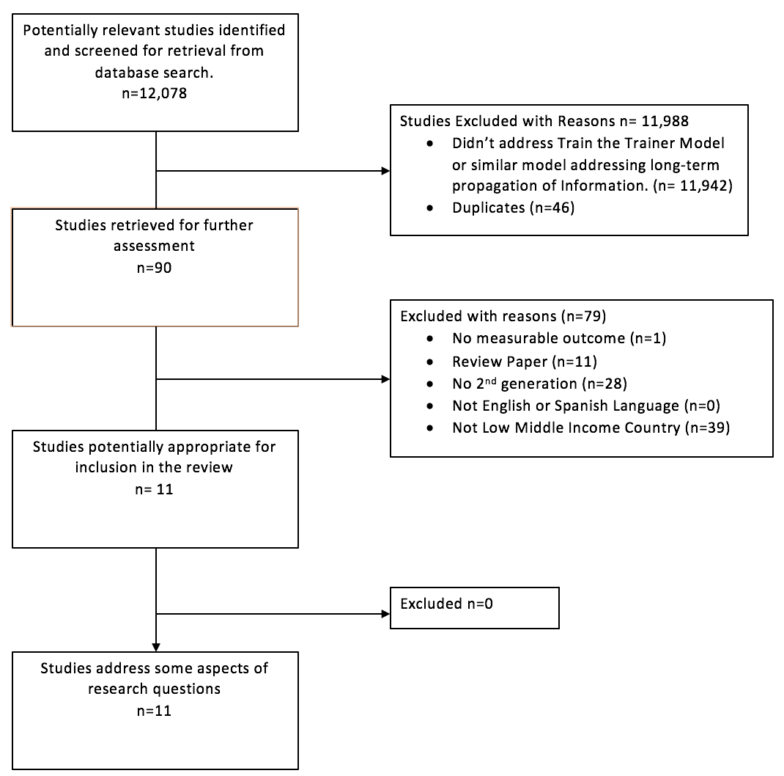
Train the Trainer as an Effective Model for the Propagation of Resuscitation Information
In a Low Resource Setting: A Systematic Review
Chance Anderson¹ M.S., Breena Taira² M.D.
University of California, Davis School of Medicine 2. Olive-View UCLA Department of Emergency Medicine
INTRODUCTION or ABSTRACT
MATERIALS & METHODS
CONCLUSIONS
Each year about 7.4 million people die from sudden cardiac events around the globe, with over a third of these deaths occurring in low to middle income countries¹. Proper resuscitation training of healthcare professionals and lay-persons have been shown to increase patient survival². Cardiopulmonary resuscitation is the cornerstone of health-professional training globally; and yearly medical professionals are recertified to ensure they can perform these skills. In developed countries, such courses are easily attainable for healthcare professionals, as many employers provide such trainings using the American Heart Association course; which are financially inaccessible low resource providers.
Often, discussed in the context of medical missions, the “train the trainer” model of course dissemination has come into vogue, with the idea that locally trained trainers will continue to train others in the low resource country after the foreign experts have left. Recently, teams of experts from high resource countries traveled to low resource settings to initiate a variety of resuscitation trainings using the train the trainer model.
To our knowledge there are no previously published systematic reviews, addressing train the trainer as a viable model for long-term propagation of resuscitation training in low resource settings. The aim of this study is to review all available evidence for the Train the Trainer method as a model for the propagation of resuscitation knowledge in low resource settings. Such evidence could provide an initial framework for universally adopted guidelines to support the development of long-term resuscitation courses in low resource settings.
Methods:
This review was planned, conducted, and reported in adherence to PRISMA guidelines standards of quality for reporting systematic reviews. This was a planned analysis to identify articles that address the long-term propagation of a train the trainer model of resuscitation in developing countries.
PICO Question:
This review sought to address the PICO (Patient/population, Intervention, Comparator, Outcome) question: “In resuscitation education in developing countries (P), does the train the trainer model (I) compared with existing strategies (including none) (C) improve the ability to perpetuate resuscitation education (O)”?
The authors also asked several secondary questions of relevance to probe further into characteristics of reported train the trainer programs. These included: 1) What is the evidence for train the trainer as a method of disseminating resuscitation skills? 2) What is the optimal length of contact prior to allowing new trainers to teach? 3) How long do train the trainer programs continue to propagate? 4) What are the barriers/facilitators for new trainers that wish to continue the program by teaching their own courses (i.e. equipment needs, facilities, teacher burnout)? 5) Are there predictors that would allow us to know prior which train the trainer programs will succeed? 6) What is the amount of degradation expected when the new trainers teach? What can be done to minimize this? 7) What are the alternatives to train the trainer? 8) Is this the most cost effective way to disseminate information on the country level? 9) Is this the fastest way to disseminate information on the country level
Little evidence exist to support the ”Train the Trainer” model’s ability to propagate long-term
Government support at various levels of program implementation appears to aid in a programs success
Programs initiated by a country’s government seem to have long-term propagation potential
Lack of funding and materials (i.e lack of training mannequins are a pervasive barrier of program success.
All characteristics assess have little evidence (see objectives)
There remains little evidence to implement to support implementations of universal guidelines to assist trainers seeking to initiate new programs.
REFERENCES
Cardiovascular diseases (CVDs). (n.d.). Retrieved February 13, 2017, from http://www.who.int/mediacentre/factsheets/fs317/en/
Iwami T, Nichol G, Hiraide A, Hayashi Y, Nishiuchi T, Kajino K, Morita H, Yukioka H, Ikeuchi H, Sugimoto H, Nonogi H, Kawamura T. Continuous improvements in "chain of survival" increased survival after out-of-hospital cardiac arrests: a large-scale population-based study. Circulation. 2009 Feb 10;119(5):728-34.
Xu T, Wang HS, Ye HM, Yu RJ, Huang XH, Wang DH, Wang LX, Feng Q, Gong LM, Ma, Y, Keenan W, Niermeyer S. Impact of a nationwide training program for neonatal resuscitation in China. Chin Med J (Engl). 2012 Apr;125(8):1448-56.
Goudar SS, Somannavar MS, Clark R, Lockyer JM, Revankar AP, Fidler HM, Sloan NL, Niermeyer S, Keenan WJ, Singhal N. Stillbirth and newborn mortality in India after helping babies breathe training. Pediatrics. 2013 Feb;131(2):e344-52.
Young S, Hutchinson A, Nguyen VT, Le TH, Nguyen DV, Vo TK. Teaching paediatric resuscitation skills in a developing country: introduction of the Advanced Paediatric Life Support course into Vietnam. Emerg Med Australas. 2008 Jun;20(3):271-5
de Paiva EF, Padilha Rde Q, Sgobero JK, Ganem F, Cardoso LF. Disseminating cardiopulmonary resuscitation training by distributing 9,200 personal manikins. Acad Emerg Med. 2014 Aug;21(8):886-91.
Carlo WA, Goudar SS, Jehan I, Chomba E, Tshefu A, Garces A, Parida S, Althabe F, McClure EM, Derman RJ, Goldenberg RL, Bose C, Hambidge M, Panigrahi P, Buekens P, Chakraborty H, Hartwell TD, Moore J, Wright LL; First Breath Study Group. High mortality rates for very low birth weight infants in developing countries despite training. Pediatrics. 2010 Nov;126(5):e1072-80.
OBJECTIVES
SECTION HEADER PLACEHOLDER
Use current primary literature to assess the effectiveness of Train the Trainer as a model for disseminating Resuscitation information in Low Income Settings
Identify factors that lead to the success and long-term propagation of these programs
Evaluate evidence for Train the Trainer as a method of disseminating resuscitation skills.
Assess the optimal length of contact prior to allowing new trainers to teach
Assess train the trainer propagation length for ideal time frame for success
Identify barriers/facilitators for new trainers wanting to continue teaching their own course
Identify program success predictors
Assess the amount of knowledge degradation expected when a new trainer teaches a course
Identify alternatives to train the trainer for resuscitation information
Assess the cost effectiveness of a train the trainer program compared to comparable programs
RESULTS
SECTION HEADER PLACEHOLDER
SECTION HEADER PLACEHOLDER
SECTION HEADER PLACEHOLDER
SECTION HEADER PLACEHOLDER
SECTION HEADER PLACEHOLDER
SECTION HEADER PLACEHOLDER
SECTION HEADER PLACEHOLDER
SECTION HEADER PLACEHOLDER
SECTION HEADER PLACEHOLDER
SECTION HEADER PLACEHOLDER
SECTION HEADER PLACEHOLDER
SECTION HEADER PLACEHOLDER
SECTION HEADER PLACEHOLDER
SECTION HEADER PLACEHOLDER
 | Course
Study Author | Training Type | # of Generations | Participants | Evaluation Tools | Outcomes
 |  |  |  |  | Knowledge | Skills | Patient Outcomes
Urbano et. al | Pediatric and Neonatal Resuscitation | 4 | Doctors from Paediatric ICU, Paediatric EM, and Paediatric anaesthesiologist | pretraining and post-training written evaluation, Practical infant/child basic and advanced CPR performance, Self-efficacy basic and advanced CPR | Yes | Yes | No
Olsen et. al | Neonatal Resuscitation | >3 | Midwives | Written, Interview-administered survey, with multiple choice test assessing core resuscitation knowledge | Yes | Yes | No
Ferreira de Paiva et. al | Basic CPR | 3 | Lay-Persons | Number of people trained | No | No | No
Rajapakse et. al | ACLS/ALS | 3 | Non-Specialist Doctors | Pre and post training knowledge and skills, through 30 multiple choice questions and video recorded simulated scenarios of a cardiac arrest | Yes | Yes | No
Enweronu-Laryea et. al | Neonatal Resuscitation | 3 | Nurses, Nurse anaesthetists, midwives, and physicians | Cognitive knowledge and Resuscitation skills | Yes | Yes | No
Carlo et. al | Newborn Care and Resuscitation | 3 | Birth attendants, nurses, midwives, and physicians | Rates of stillbirths and perinatal deaths, Apgar score | No | No | Yes
Tao et. al | Neonatal Resuscitation | > 2 | Obstetricians, Pediatricians, Midwives | Megacode performance test with 240 participants, neonatal deaths pre/post-training rates | No | No | Yes
Boo et. al | Neonatal Resuscitation | 3 | Doctors, nurses, medical assistant | Written evaluation, practical skills evaluation | Yes | Yes | No
Carlo et. al | Neonatal Resuscitation | 3 | Birth attendants, nurses, midwives, and physicians | Fetal heart rate, signs of life at delivery, and Apgar score | No | No | Yes
Shivaprasad et. al | Neonatal Resuscitation | 3 | Physicans, nurses, and birth attendants | Knowledge, skills, and OSCE assessment; Birth outcomes | Yes | Yes | Yes
Young et. al | Pediatric Resusciation | 3 | Doctors and Nurses | Number of people trained | No | No | No
Program length varied with each study, with little evidence supporting why each study chose its particular time-frame
Lack of funding and training materials were noted as pervasive barriers to a new trainers success and the length of program propagation⁵. No article compared any train the trainer alternatives for teach resuscitation skills
No articles address the cost effectiveness of running such a course
Using train the trainer for resuscitation training has various patient outcomes. There was a decrease in neonatal mortality
TEXT PLACEHOLDER
TEXT PLACEHOLDER
TEXT PLACEHOLDER
TEXT PLACEHOLDER
TEXT PLACEHOLDER
TEXT PLACEHOLDER
TEXT PLACEHOLDER
TEXT PLACEHOLDER
TEXT PLACEHOLDER
TEXT PLACEHOLDER
TEXT PLACEHOLDER
ACKNOWLEDGEMENTS
Thank you to the MSRF funding committee for providing the financial support to conduct and complete this research project.
Thank you to Dr. Breena Taira for your guidance and mentorship during the completion of this project.
Thank you to my parents (John and Brigitte Anderson) and my fiancé (Michelle Rodriguez) for their continuous love and support during my medical education.
PICTURE PLACEHOLDER
PICTURE PLACEHOLDER
PICTURE PLACEHOLDER
PICTURE PLACEHOLDER
PICTURE PLACEHOLDER
PICTURE PLACEHOLDER
PICTURE PLACEHOLDER
PICTURE PLACEHOLDER
PICTURE PLACEHOLDER
PICTURE PLACEHOLDER
PICTURE PLACEHOLDER

